Slide 1
Team Vision

Slide 2
OUR TEAM
Yancho Karapchanski
Mentor
Kaloyan Dimov
Database developer
Stoyan Kolev
Frontend
developer
Ivan Zlatinov
Backend developer

Slide 3










USED PROGRAMS
Code & Collaborative Service
Design
Project Development
Presentation and Communication

Slide 4
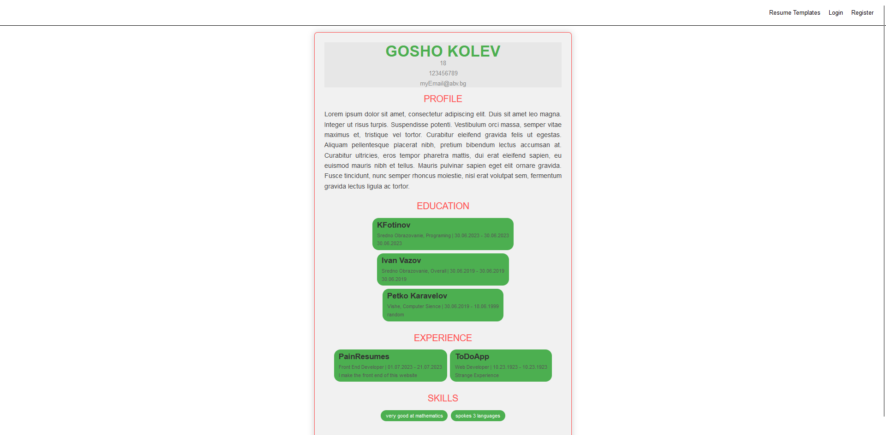
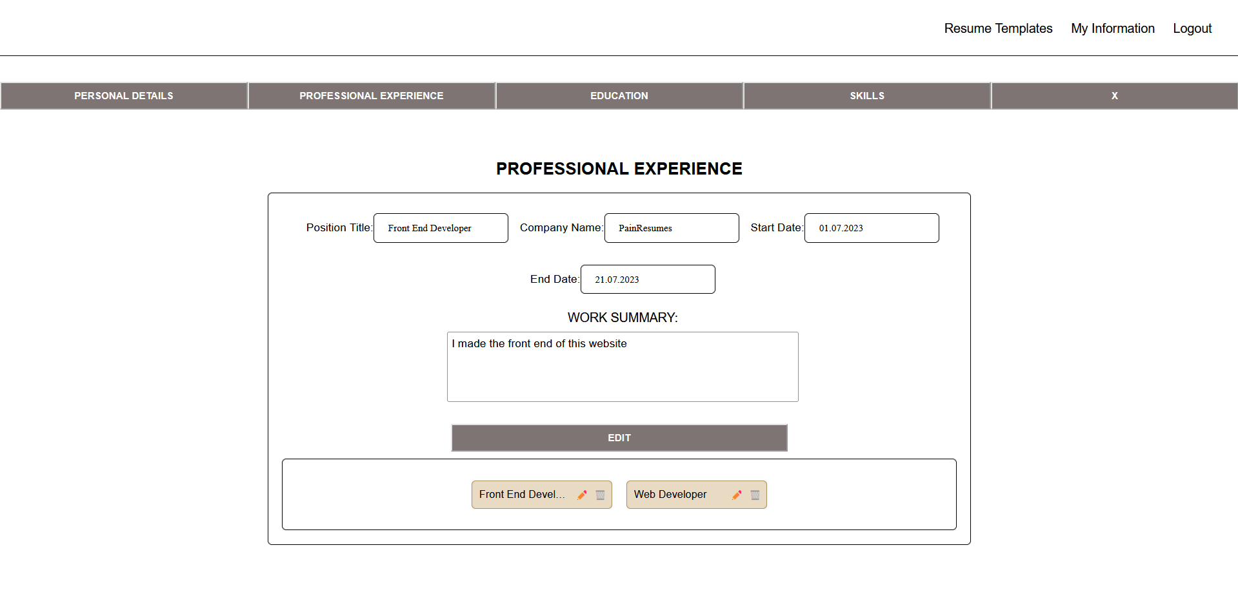
OUR IDEA

Slide 5
NOW LET’S GET TO THE PROJECT!

Slide 6
THANK YOU FOR THE ATTENTION

